Slide 1

Designing your CA app
Susan McKeever

Slide 2
Intro
Diving straight from the “idea” to coding is a bad idea
Need to articulate your design:
What it does
How it does it
What it looks like -
Your design enables someone to develop it - good way

Slide 3
Specifics:
What it does
Functionality
Design Artefacts: Use cases; Description of what the app does; screen flows
How it does it
Technical info:
Design Artefacts: Class diagrams; Database ERD, Tech arch (if cloud)
What it looks like
Design artefacts: Screen designs (inc. navigation – check existing app)

Slide 4
Usability of your app
Nielsen’s 10 usability heuristics still apply
+
Minimise data entry - never ever get a user to type in data unnecessarily (you will need some data entry). E.g. drop down boxes are easier than typing full value;
Avoid overcrowding the screen
Get someone else to check it’s self explanatory
Adopt sensible navigation (look at existing apps)

Slide 5
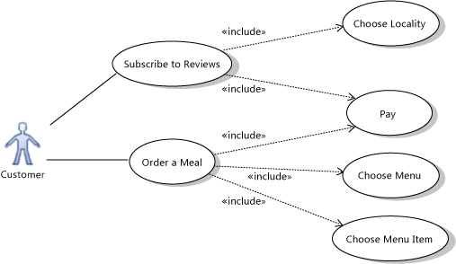
Reminder:

Slide 6



Functions
A "uses" relationship indicates that one use case is needed by another in order to perform a task. An "extends" relationship indicates alternative options under a certain use case.
Users

Slide 7
Design spec should contain
Use cases;
Description of what the app does;
Screen flows
Class diagrams; Database ERD
Tech arch diagram if including cloud
Screen designs (inc. navigation – check existing app)
If any of it is hand drawn, make sure they are legible. 2nd Monday Nov – firstname_surname.zip submission in webcourses

Slide 8
Marking
No separate grade (feedback)
If not done, multiplier of 0.8 used on app assignment
The right way to approach a user application

